Slide 1
FruitLook Data Manual

Slide 2
FieldLook Data Products
Moisture Data | Unit | Description
Actual Evapotranspiration | mm/ week | How much water is used to produce crops each week? Includes crop, cover crop and weed transpiration, as well as evaporation from the soil surface.
Evapotranspiration Deficit | mm/ week | The difference between an optimal and actual ET for a given area. A high deficit means plants are experiencing water and/or other stresses.
Biomass Water Use Efficiency | kg/m³ water | How efficiently are plants using water? This shows how much biomass is produced per unit of water consumed by evapotranspiration.
Growth Data | Unit | Description
Biomass Production | kg/ha/week | The number of kilograms of dry plant matter produced per hectare per week. Includes leaves, stems, new shoots, fruits, roots as well as cover crops and weeds.
Cumulative Biomass Production | kg/ha | Cumulative actual biomass production from start of the monitoring period
Leaf Area Index | - | A snapshot of the area of leaves on plants compared to the area of soil.
Vegetation Index | - | Universally employed indicator of crop vitality and vigour. A high index means healthy and strong growing vegetation
Mineral Data | Unit | Description
Nitrogen content in top leaf layer | kg/ha | A snapshot of the amount of nitrogen in the total leaf surface of your crop. Directly measured in kilograms per hectare.
Nitrogen content all leaves | kg/ha | The nitrogen which is present in only the upper leaf layer. A snapshot, expressed in kilograms per hectare.

Slide 3
Biomass Production [kg/ha/week]

Slide 4
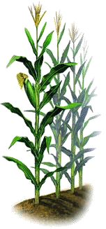
Biomass Production: What is it?
The Biomass Production is the total dry matter increase of your crop in kg/ha/week.
The biomass growth includes roots, shoots, fruits, twigs, leaves and all in
between (including cover crop).
It is strongly influenced by crop condition, moisture availability and climatic circumstances.
It does NOT represent the total absolute amount of biomass on a field, it is
a measure of growth per week.
Tassle
Leaves
Corn
Total
Biomass
Stems
Roots
T1
T2
T3
T4
Timestep

Slide 5
Biomass Production: What can you expect? – 1/2
The Biomass Production can vary between no production all the way up to
2,500 kg/ha/week.
Younger crops will produce less biomass than full bearing crops.
Small variations in biomass production from week-to-week are likely. These are most likely caused by variation in meteorological conditions. For example, during a cloudy week less energy for photosynthesis causes the biomass production to drop. Excellent weather conditions for crop growth cause the biomass production to increase.

Slide 6
Biomass Production: What can you expect? – 2/2
Field crops: shows a strong curvature linked to the time periods of
emergence, vegetative growth, generative growth and harvest.
Deciduous trees: shows a bell-shaped curve with peak of growth in the midst of the season. At the beginning of the season the crop is not yet fully developed. At the end of the season the leaves start colouring, chlorophyll breaks down and the fruit crop enters a period of dormancy. Climatic conditions are also of influence: in the midst of summer solar energy, used for photosynthesis, is more abundant than in spring and fall.
Evergreen trees: shows a bell-shaped curve, but less distinguished then for deciduous trees. The general curve is mainly due to climatic changes (amount of solar energy) over the year rather than changes in leaf area of the crop.

Slide 7
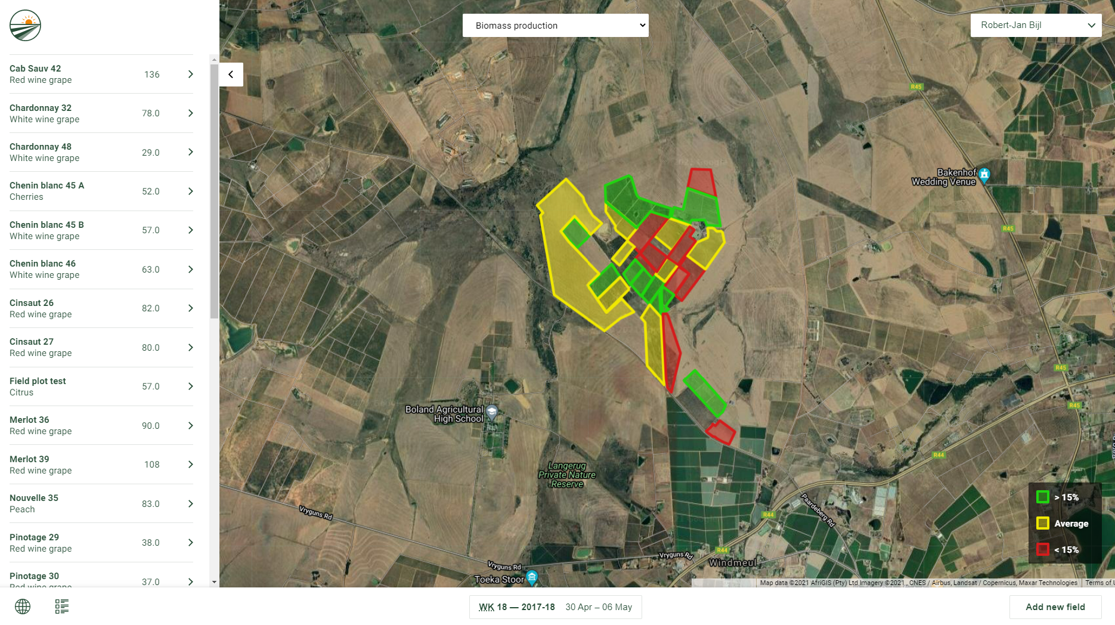
Biomass Production: Map Overview
Biomass Production is a direct indicator of crop growth.
Every week, the Map Overview displays which fields are growing on, below or above the average of your farm. The fields are benchmarked against the average growth for that specific week, and for their specific crop and/or cultivar type.
The fields colored Red indicate below average growth. These are fields that might require additional attention in your upcoming week.

Slide 8
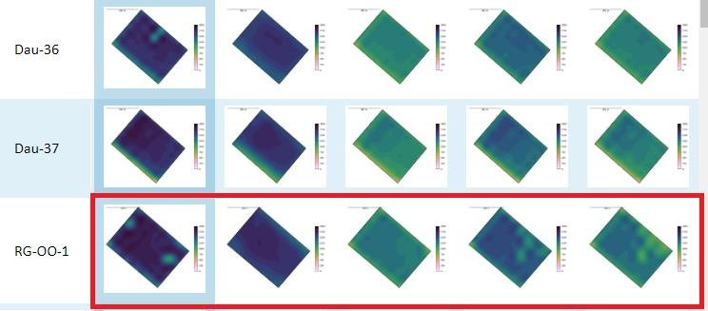
Biomass Production: Spatial View – 1/2
The Biomass Production of a single management field should have a homogeneous outlook throughout the season.
Strong variation in a field might indicate part of your field is responding less well to your field management. This could for
example be due to underlying variation in soil conditions.
In-season variation in Biomass Production can also be caused by hazards like disease or pests. The Biomass Production can be used to delineate areas affected by pests.

Slide 9
Biomass Production: Spatial View – 2/2
If variability in biomass production in a field is consistent it will likely indicate a structural difference, like variation in soil type. You can use this to inform decision making on:
Soil samples
Leaf samples
Soil moisture probes
To ensure the samples or probe locations capture a representative
area(s) of your field.
You can even use these insights to inform decision making on new field, irrigation system or farm layout.

Slide 10
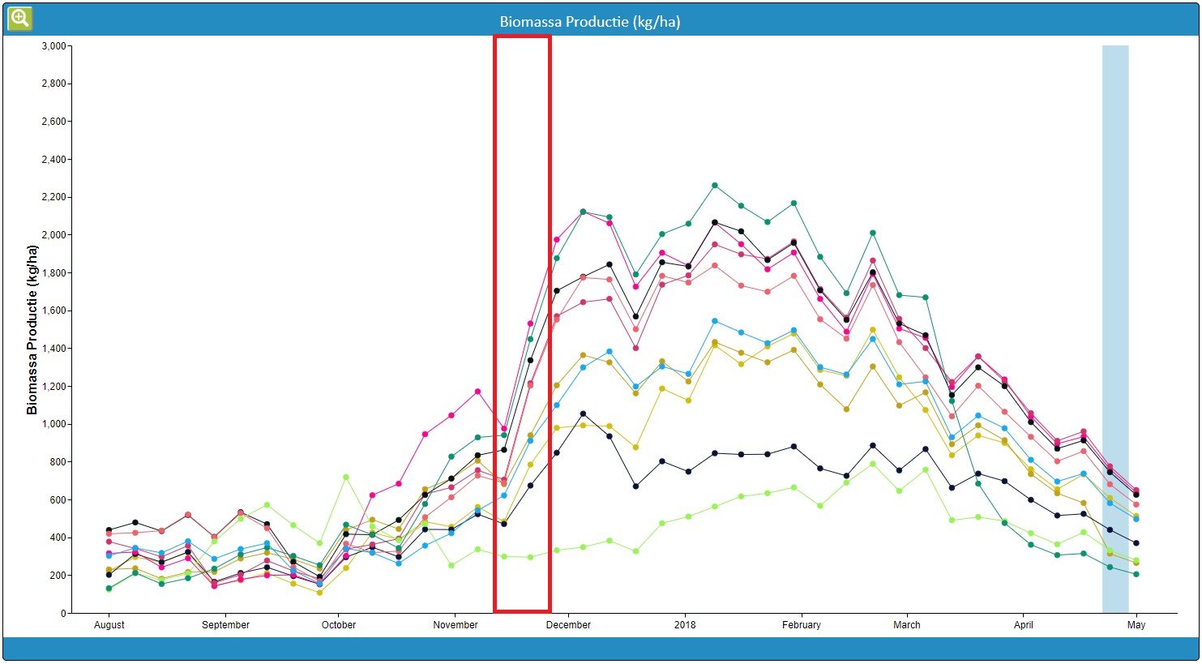
Biomass Production: Time Series
You can use the Graph to monitor continuous development throughout the growth season.
The best approach for evaluating biomass production in a field is to compare individual fields to the farm norm.
Do so for similar crop and cultivar types:
If all fields show a similar drop then you are likely looking at a weather induced drop.
If fields show a different trend compared to the rest, this might indicate issues.
In this example, there is a drop visible in the red delineated area. This is most likely weather related. However, after the drop it is visible the blue and gold coloured fields do not recover well. These fields need attention in the upcoming week.

Slide 11
Biomass Production: What else is good to know?
The Biomass Production describes crop growth over a full week. The date listed on FieldLook reflects the last day of the captured week.
There is a correlation between Biomass Production and processes reflected in the other data components. If Biomass Production drops from a particular field, look into the Vegetation Index, Biomass Water Use Efficiency and Evapotranspiration Deficit to see if this drop is reflected in one of these parameters.

Slide 12
Vegetation Index [-]

Slide 13
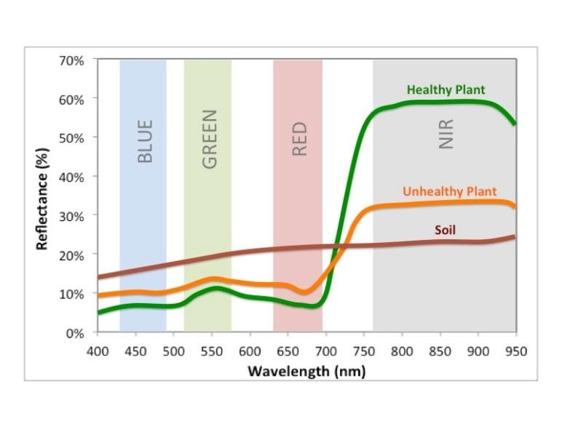
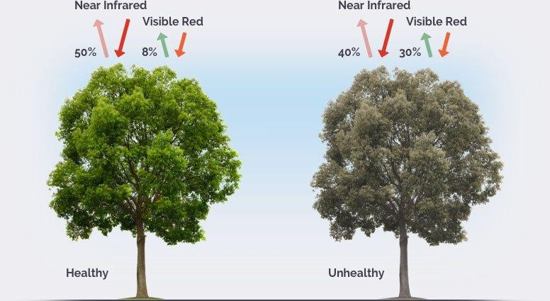
Vegetation Index: What is it?
The Vegetation Index (= NDVI) is an indicator of the vitality of your crop.
It results from reflection in Red and Near-Infrared light.
A high index means healthy, vigorous and dense vegetation.
It is strongly influenced by chlorophyll content and the cell structure of leaves.
1) https://midopt.com/solutions/color-imaging/ndvi/
2) https://eos.com/ndvi/

Slide 14
Vegetation Index: What can you expect?
The Vegetation Index of cropped land normally has a value between 0.2
and 0.9.
The Vegetation Index is affected by all plants growing on that patch of land, including cover crop, weeds and your crop itself.
In seasonal crops, like wheat or maize, the curve of the Vegetation Index describes onset, vegetative growth, ripening and harvest and has a strongly curved profile.
In deciduous fruit crops this seasonal curve is less apparent. Instead a slow increase or even flat Vegetation Index profile can be expected during the season. The Vegetation Index will decline at the onset of leaf fall.
Evergreen trees show a stable profile throughout the year.

Slide 15
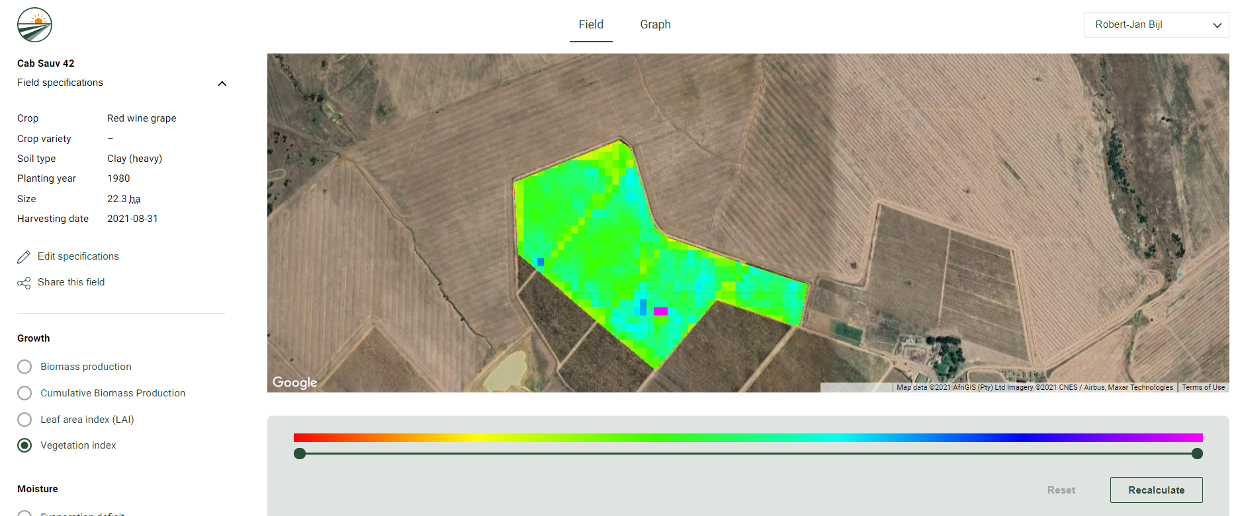
Vegetation Index: Spatial View
The Vegetation Index of a single management field should have a homogeneous outlook throughout the season.
The top image shows a relatively homogeneous field, in the bottom image the western part of the field is more vigorous then the eastern part.
Consistent variation in a field might indicate part of your field is responding less well to your field management. This could for example relate to variation in soils.
Sudden weak spots in your Vegetation Index can be caused by hazards like disease or pests, or various other production issues.

Slide 16
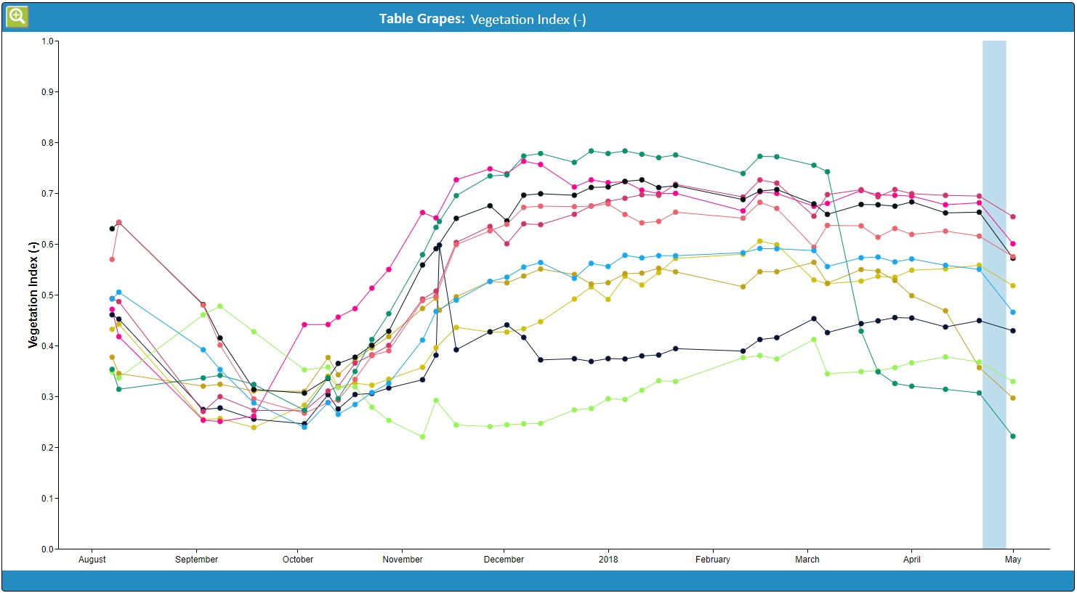
Vegetation Index: Time series
You can use the temporal profile to • easily see if your fields show continuous development throughout the growth season.
If a strong decline is visible and no changes have been made in your field management (for example no extensive pruning) possibly something is going amiss in your field.

Slide 17
Vegetation Index: What else is good to know?
The date of the Vegetation Index map data on FieldLook is the actual date of the satellite recording: hence this parameter layer provides a direct snapshot of your field condition at that specific date.
Please take into account type of trellis system, pruning/thinning, row distance, cover crops, weeds all influence the Vegetation Index. For example: where 0.8 is a value often seen in table grape fields this is rarely seen for wine grapes, due to a different manner of trellis design.

Slide 18
Actual Evapotranspiration (Actual ET) [mm/week]

Slide 19
Actual ET: What is it?
Transpiration through the stomata in plant leaves (T) in mm
The Actual Evapotranspiration (ET) is the sum of the amount of water that is evaporated from the soil (E) and the amount of water that is lost through transpiration by the crop,
cover crop and/or weeds (T).
Where non-consumed water can be recaptured for downstream use, or replenishes the groundwater, water consumed by evapotranspiration cannot.
It represents the actual amount of water consumed during the crop production process and is expressed in mm/week.
Evaporation from water on surfaces (soil, leaves)
(E) in mm
Rootzone where water is taken up
Total volume of water used for crop production (mm/timestep)

Slide 20
Actual ET: What can you expect? – 1/2
The Actual Evapotranspiration can vary between no or little
evapotranspiration and values as high as 60 mm/week.
Evapotranspiration is normally lower at the beginning and at the end of the season as the crop development is respectively just initiated or over its peak. Peak values are typically reached in mid-summer, but greatly depend on the plant physiology and management.
Climatic conditions are also of influence: in the midst of summer solar energy is more abundant than in spring and fall meaning more energy is available for the evapotranspiration of water. Whether or not this potential is reached is strongly dependent on water availability.

Slide 21
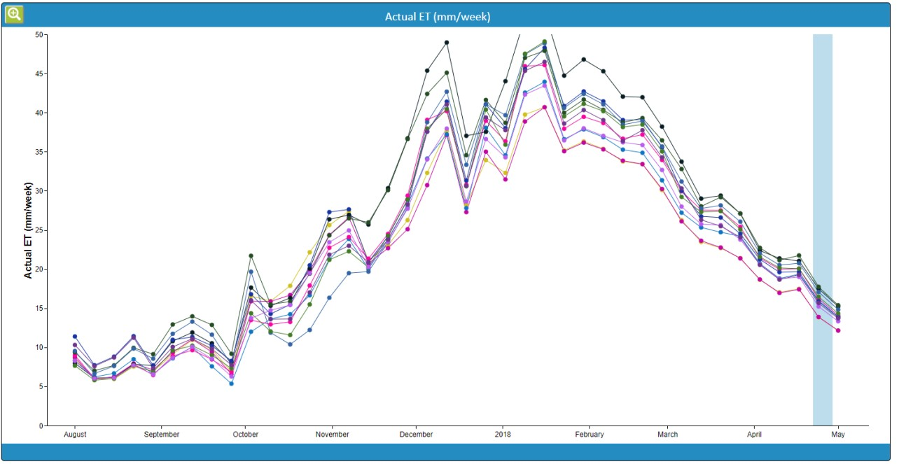
Actual ET: What can you expect? – 2/2
Small variations in evapotranspiration from week-to-week can be visible.
These are most likely caused by variation in meteorological conditions:
An increase in air temperature will mean more potential for evapotranspiration.
A decrease in relative humidity (dryer air) will increase the water potential gradient between the leaf and the surrounding air layer which also enhances evapotranspiration.
During clear conditions more energy is coming from the sun for photosynthesis which encourages the stomata to open. Cloudy conditions reduce potential evapotranspiration amounts.
Wind still conditions decrease transpiration as water vapor accumulates close to the leaf surface, causing the water potential gradient between leaf and surrounding air to drop.
The curve of the Actual ET is typically bell- shaped. Smaller drops, present in all fields of a farm, might be caused by weather conditions.

Slide 22
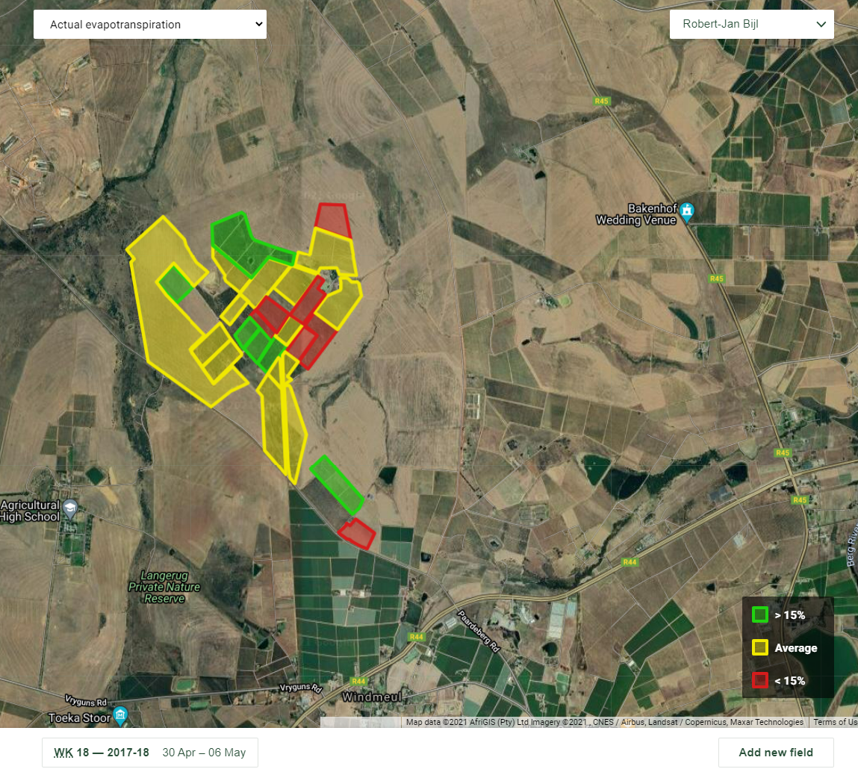
Actual ET: Map Overview
Actual ET is a direct indicator of crop water consumption.
Every week, the Map Overview displays which fields are using water below or above the average of your farm. The fields are benchmarked against the average Actual ET for that specific week, and for their specific crop and/or cultivar type.
The Red fields indicate below average water consumption. This can be due to the fact that these are younger fields.
The Green fields indicate above average water consumption. This might indicate overuse of water.

Slide 23
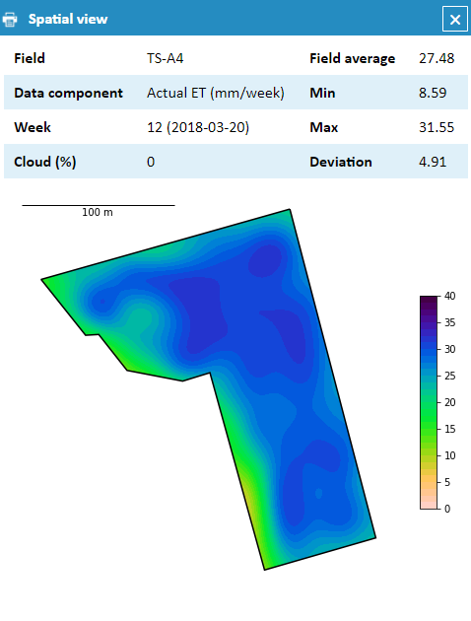
Actual ET: Spatial View
Monitoring Actual ET on a regular basis gives a direct insight in crop water consumption. Areas of low crop water use can be identified.
Differences in ET within fields might indicate points of water logging or faulty irrigation equipment and suggest the opportunity for improved water management in the field to reduce spatial variation in Actual ET.
This field shows variation in Actual ET within the field, with a particular wet spot in the northern part of the field.

Slide 24
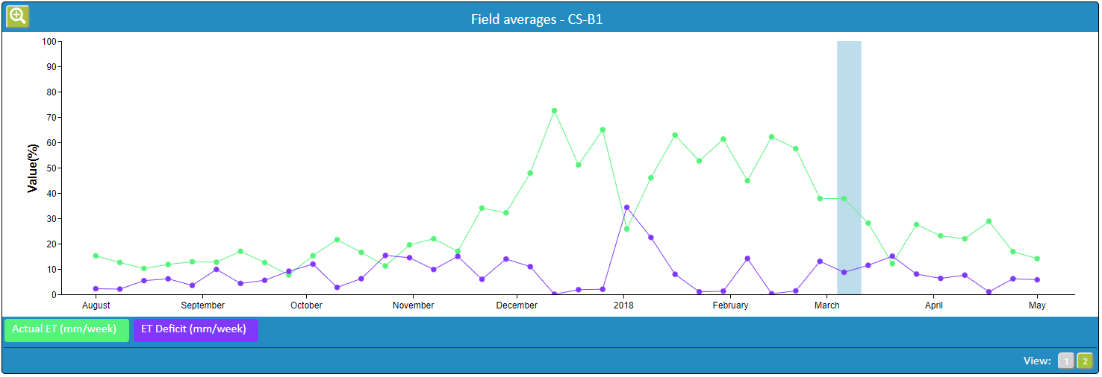
Actual ET: Time Series
Via Graph, see if your fields show the expected rate of water consumption throughout the growth season.
The combination of Actual ET and Et Deficit (see next section) can show whether or not your field is stressed. This can be particularly well visualized in Single Field.
A drop in Actual ET without an
increase in ET deficit is most likely caused by meteorological circumstances.
If a sudden trend-break of your normal curve shows a drop in Actual ET combined with an increase in ET Deficit and this continues for multiple weeks in a row this could be a clear indication of irrigation issues.

Slide 25
Actual ET: What else is good to know?
The Actual ET represents crop water consumption of a full week. The date listed on FieldLook reflects the last day of the captured week.
You can calculate the water use in m³ of water per week per hectare from the Actual ET. Simply multiply the value in millimetres with 10. For example, 40 mm represents 400 m³ water consumed through evapotranspiration per hectare.
Evapotranspiration can be a great help in evaluating irrigation and keeping track of the moisture status of your field. Please keep in mind the climatic circumstances strongly influence the value range of this parameter.

Slide 26
Evapotranspiration Deficit (ET deficit) [mm/week]

Slide 27
ET Deficit: What is it?
Where Actual ET is the real crop water use at a certain day, the potential evapotranspiration (Potential ET) represents the amount of water that could be evaporated and transpired under actual meteorological conditions and ample water supply.
The difference reflects the crops shortfall in what it can potentially
achieve. This is the Evapotranspiration Deficit (ET Deficit).
The ET deficit is an indicator of crop stress.

Slide 28
ET Deficit: What can you expect?
Small ET Deficits (<5mm) might be visible at certain periods over the drier
periods of a growing season.
Very hot or dry air can cause ET deficits to occur. When a crop loses too much water because the moisture gradient between leaf and surrounding air becomes too steep it tends to close off its stomata causing a decrease in evapotranspiration.
Apart from meteorological conditions factors as soil salinity, poor land fertility, the presence of hard or impenetrable soil horizons, pests and diseases and poor soil management may limit crop development and reduce evapotranspiration.
No ET Deficit over a season suggest wet conditions and it could possibly mean over-irrigation is taking place. This can best be investigated in combination with the biomass water use efficiency parameter. To determine whether a field is over-irrigated or not is challenging and requires knowledge of the crop and field.
High ET Deficit values occurring over a number of consecutive weeks suggest that the soil is drying out, the plants are possibly experiencing stress and the producer is possibly lagging behind with irrigation applications.

Slide 29
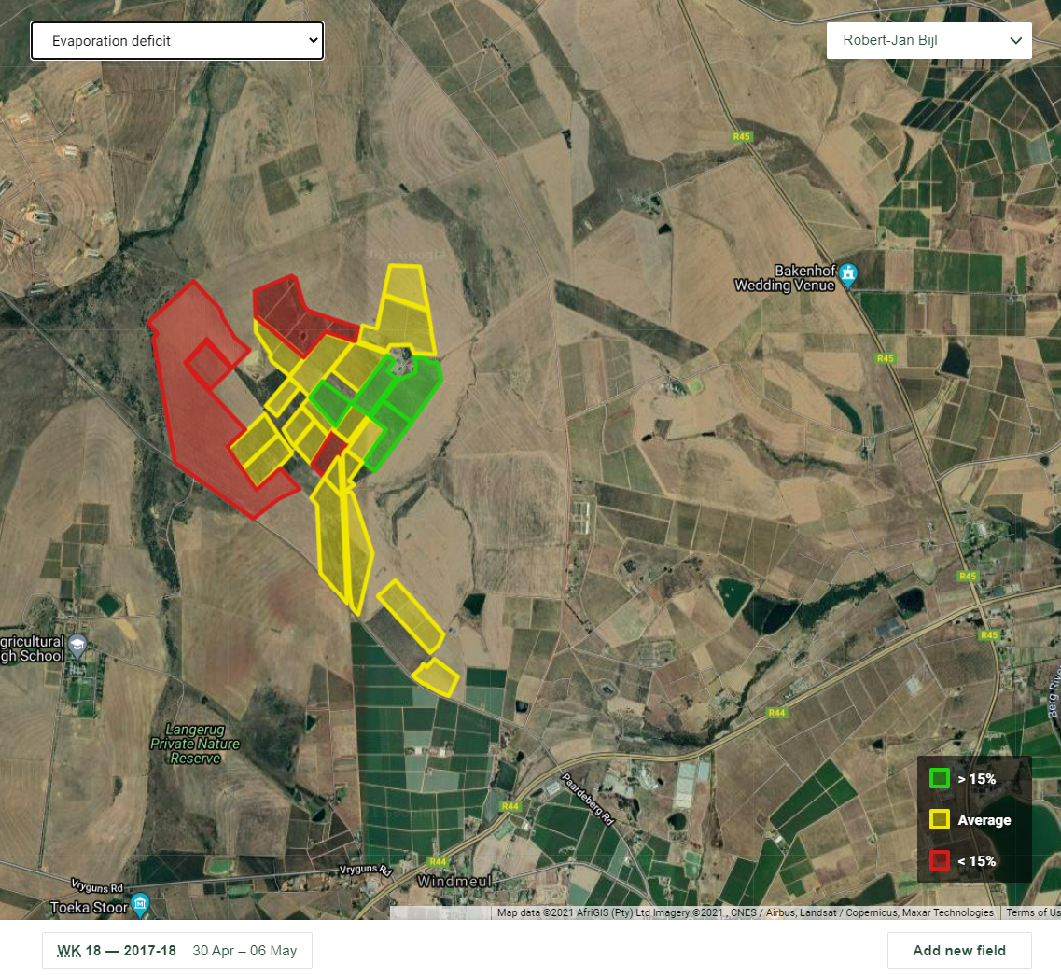
ET Deficit: Map Overview
ET Deficit is an indicator of crop stress, reflected in shortfall of evapotranspiration.
The fields in Red represent the fields which have most stress, when compared to similar fields in terms of crops and/or crop variety on your farm. The Green fields are least-stressed.

Slide 30
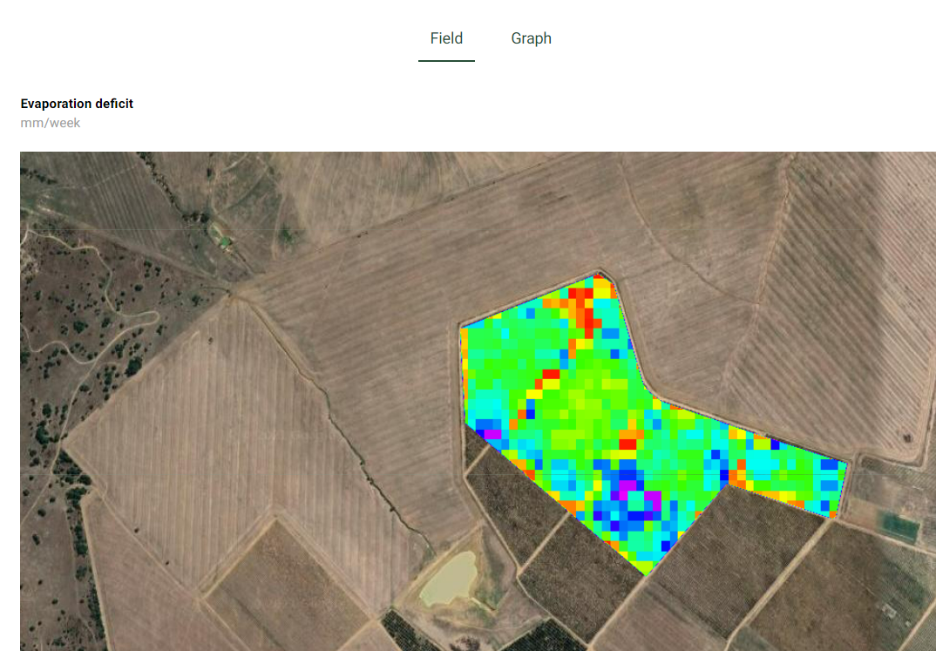
ET Deficit: Spatial View
The ET deficit represents stress. As •
such, the spatial overview can show you over time which zones of your fields stress most.
Most particularly, it can inform you which part of your field shows the first signs of stress through time.
This can help you determine where to put probes, start field visits, etc.
This fields shows variation in ET Deficit. If this particular pattern of stress occurs in multiple weeks of the season, this can indicate certain parts of your block a most susceptible to dry conditions

Slide 31
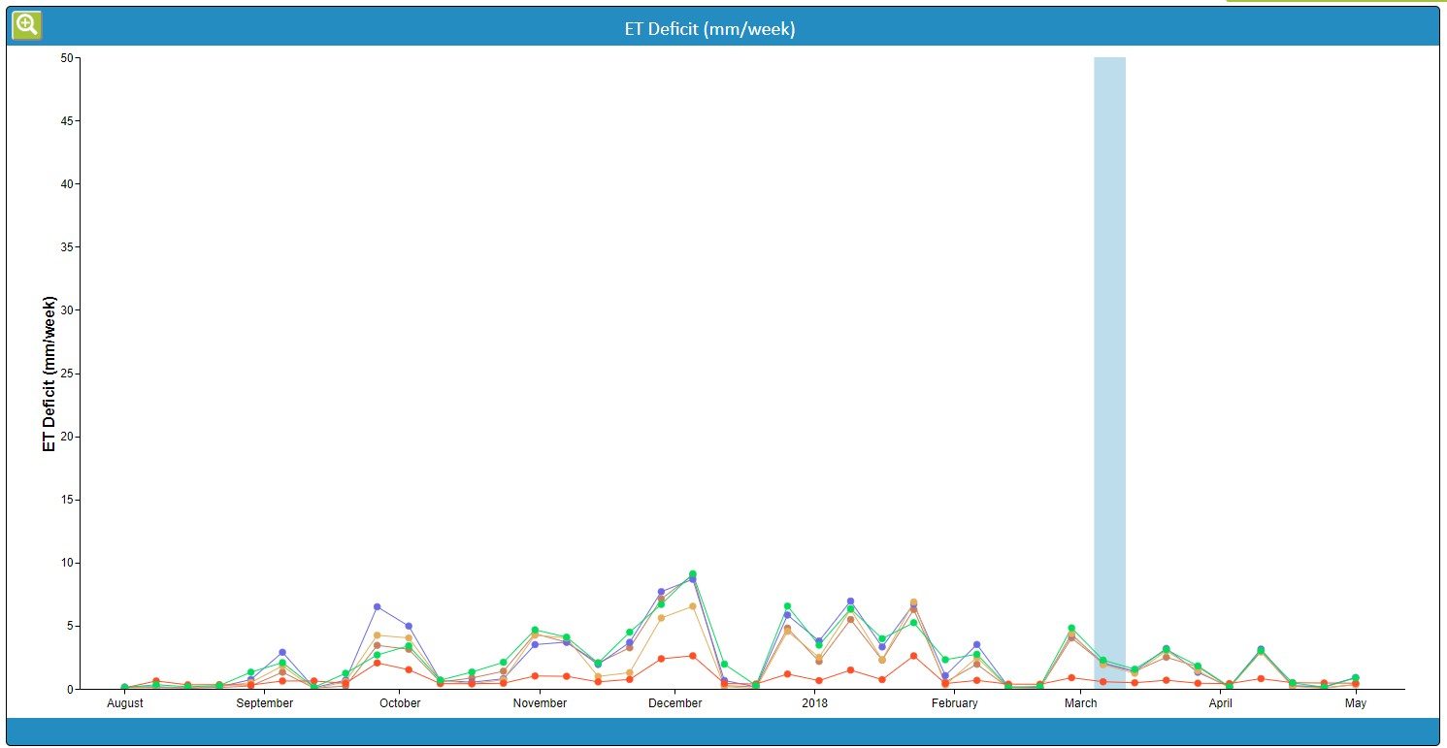
ET Deficit: Time Series
Via Graph, you can visualize stress over various production fields.
If all fields show a (limited) ET Deficit this can be due to weather conditions. Evaluate whether last week has been stressful in terms of air temperature, relative humidity or very windy.
Identify the fields which are most stressed.

Slide 32
ET Deficit: What else is good to know?
The ET Deficit represents crop water shortage of a full week. The date listed on FieldLook reflects the last day of the captured week.

Slide 33
Biomass Water Use Efficiency (Biomass WUE)
[kg biomass / m³ water]

Slide 34
Biomass WUE: What is it? – 1/2
The Biomass Water Use Efficiency (Biomass WUE) is the actually produced biomass per unit (cubic meter) of water consumed by evapotranspiration.
A high Biomass WUE is an indication of efficient water use. While the Actual Biomass Production describes the amount of biomass produced per unit of land (kg/ha), the Biomass WUE describes the amount of biomass produced per unit of water (kg/m³).
The Biomass WUE does not tell you how much water has been used to
produce a specific amount of crop yield.

Slide 35
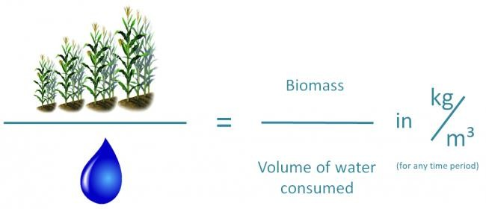
Biomass WUE: What is it? – 2/2
Higher Biomass WUE can be achieved when less water is used to produce equal biomass or when biomass production increases while total water consumption remains equal.

Slide 36
Biomass WUE: What can you expect?
The Biomass WUE can vary between no production up to 10 kg/m³.
A higher value means more efficient water use by the crop.
The Biomass WUE is influenced by many factors: to name a few, crop type,
variety, crop age and soil all have an effect.
Remember variation in Biomass WUE is not directly linked to the actual yield. This means it is not necessarily so that the high Biomass WUE cultivars also produce more yield per cubic meter of water used.

Slide 37
Biomass WUE: Spatial View – 1/2
The Biomass WUE of a single management field should have a homogeneous outlook throughout the season.
In general the Biomass WUE is a product to evaluate and optimize your irrigation system: where does your irrigation function optimal? And where not? What is the difference between these spots?
And can you improve your system to use your water more accurately?
In-season variation in Biomass WUE can also be caused by various problems, either linked to drops in Biomass Production or increase in water consumption (Actual ET).
For example, areas of low Biomass WUE might indicate water logging, possibly due to drainage problems.
Some rows in this field show a decrease in Biomass WUE after week 18. FieldLook can be used to identify these locations.

Slide 38
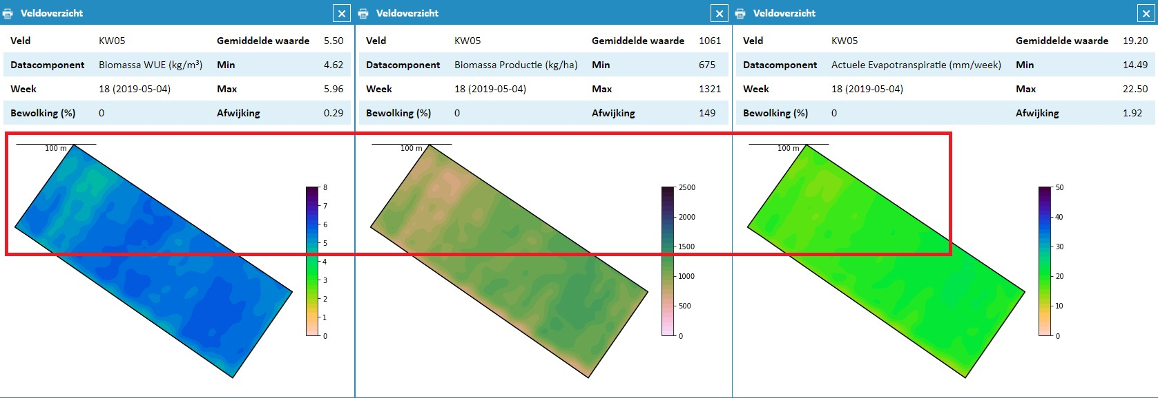
Biomass WUE: Spatial View – 2/2
Via Single Field different parameters of one block can be compared spatially.
The Biomass WUE results from the combination of Biomass Production and Actual ET.
If a change in Biomass WUE is detected this can be due to either of these parameters. In the example below, it can be clearly seen some rows in this field show reduced biomass production compared to the rest of the block.

Slide 39
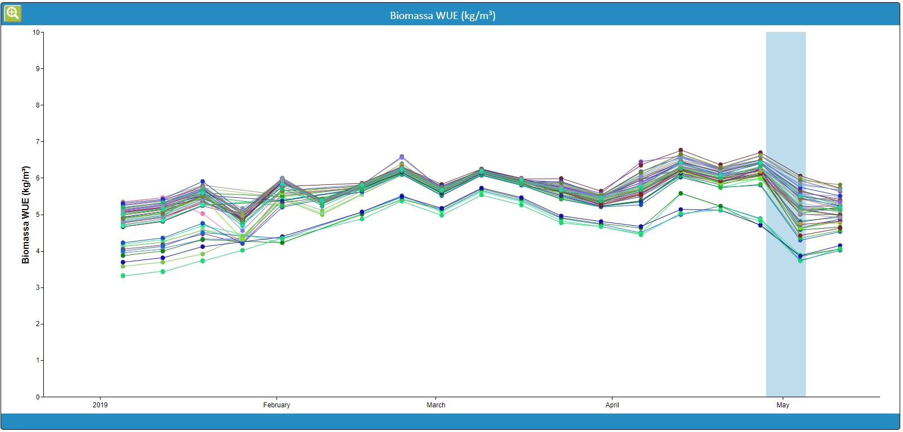
Biomass WUE: Time Series
The Biomass WUE graph is often relatively stable.
High variation between blocks is not expected, because Transpiration, which is the major component of Actual ET in a growing production field, and Biomass Production are closely linked.
Lower Biomass WUE values might be due to a higher amount of (Soil) Evaporation in a field. This might mean too much water is used or water can be applied more effectively to the crop through irrigation.

Slide 40
Biomass WUE: What else is good to know?
The Biomass Water Use Efficiency describes a full week. The date listed on FieldLook reflects the last day of the captured week.
In general the best use of the Biomass WUE information can be gained by relating it to the Actual Biomass Production and ET Deficit parameters.
Apart from on field level the Biomass WUE can also be used to compare the efficiency of water use between fields on a farm or even within a production group.

Slide 41
For more information: info@fruitlook.co.za

